Slide 1
Pigeonhole Principle -II
Prof. Dr. Quanita Kiran

Slide 3
Among the group of seven people four must be of same sex.

Slide 4
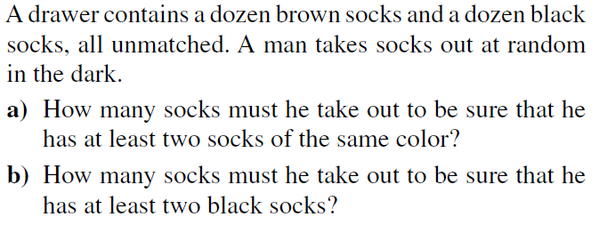

Slide 5
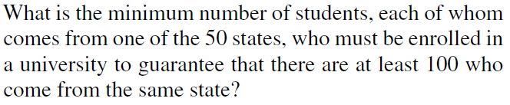

Slide 6
Show that among any group of five (not necessarily consecutive) integers, there are two with the same remainder when divided by 4.

